Slide 1
Class addresses
The lecture 5

Slide 2
Subnet Size

Slide 3
How Internet Addressing Was Meant to Work

Slide 4
How Internet Addressing Was Meant to Work

Slide 5
How Internet Addressing Was Meant to Work

Slide 6
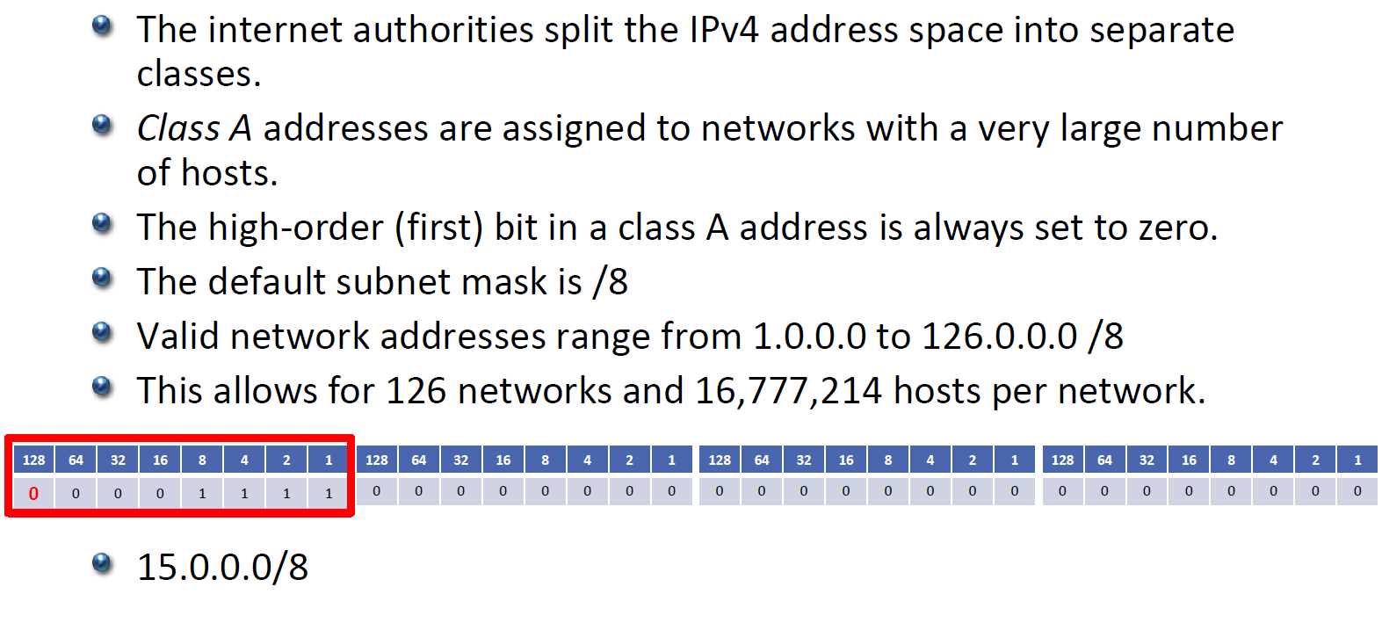
Class A

Slide 7
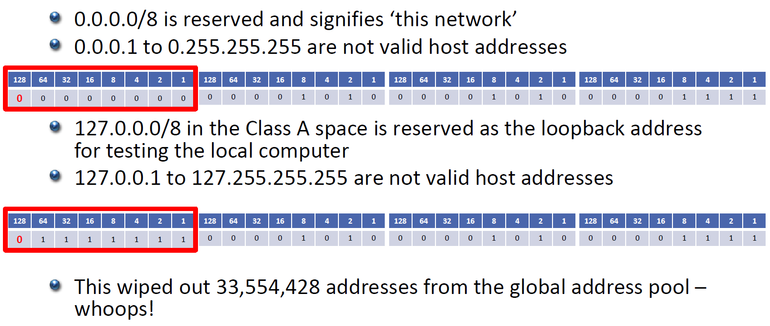
Reserved Class A Addresses

Slide 8
Subnetting

Slide 9
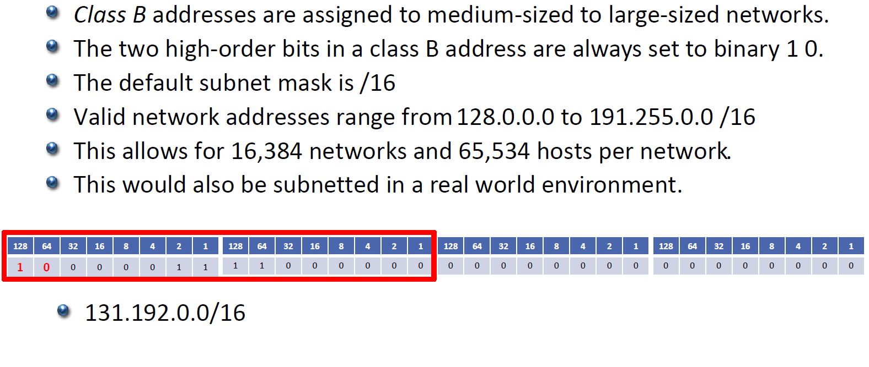
Class B

Slide 10
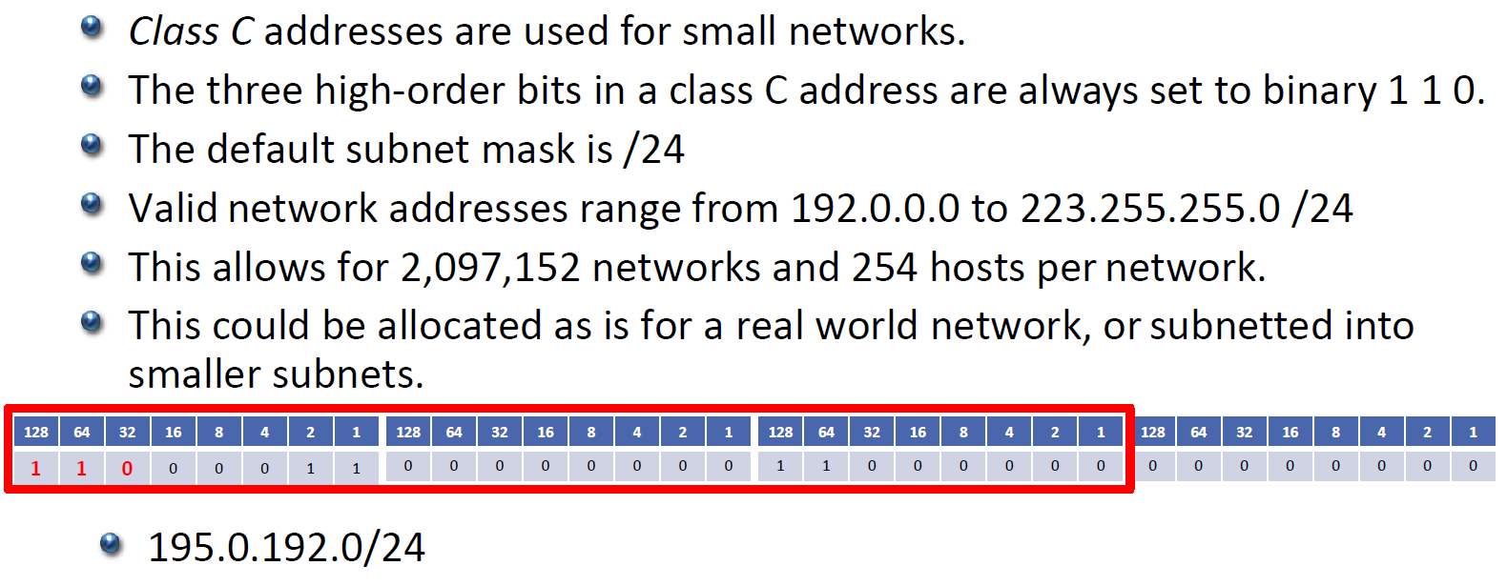
Class C

Slide 11
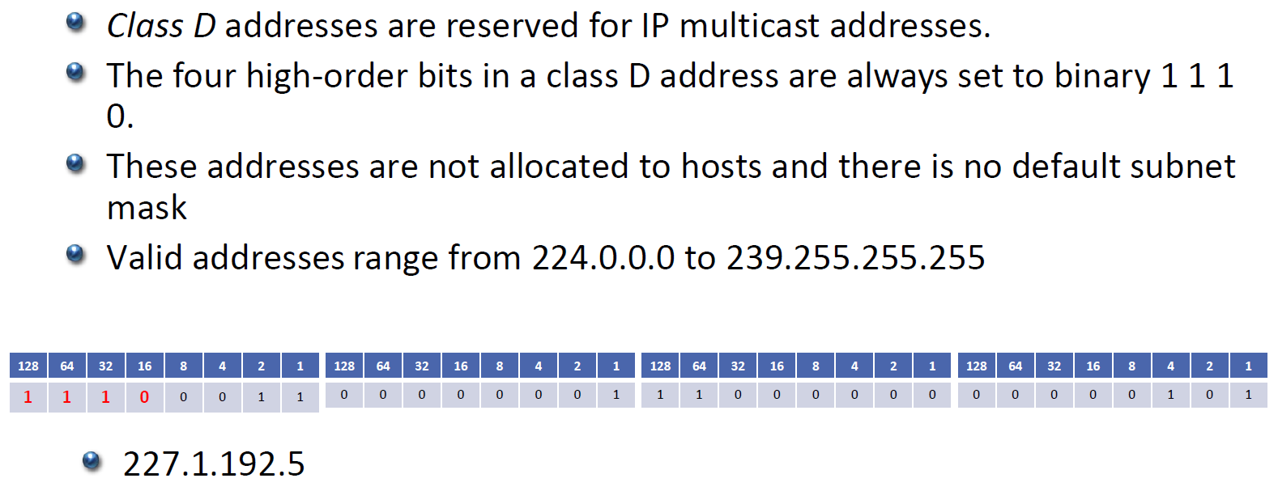
Class D

Slide 12
Unicast Traffic

Slide 13
Multicast Traffic

Slide 14
Class E

Slide 15
IP Address Class Summary

